Slide 1
VA Dashboards Group 6 1130 section
File created on: 2/3/24 6:31:38 PM EST

Slide 2
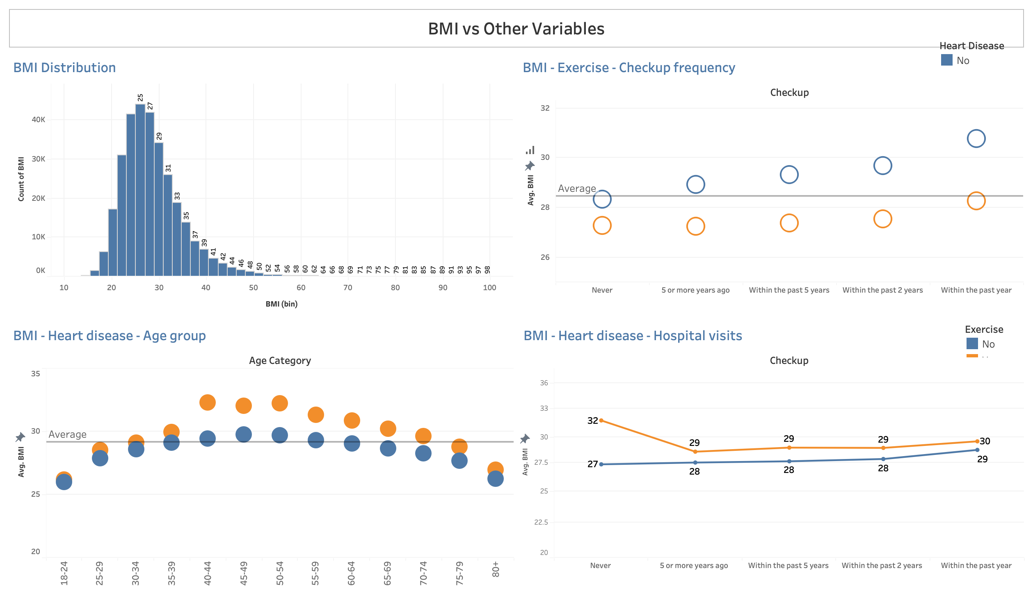

Slide 3
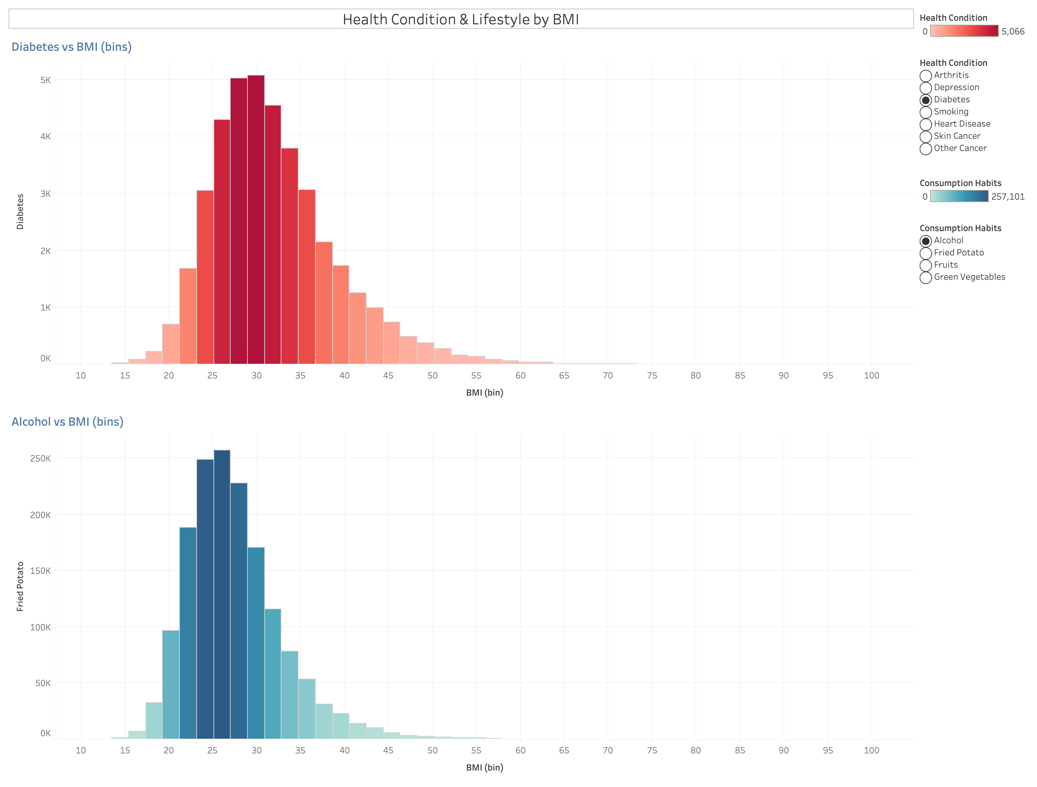

Slide 4
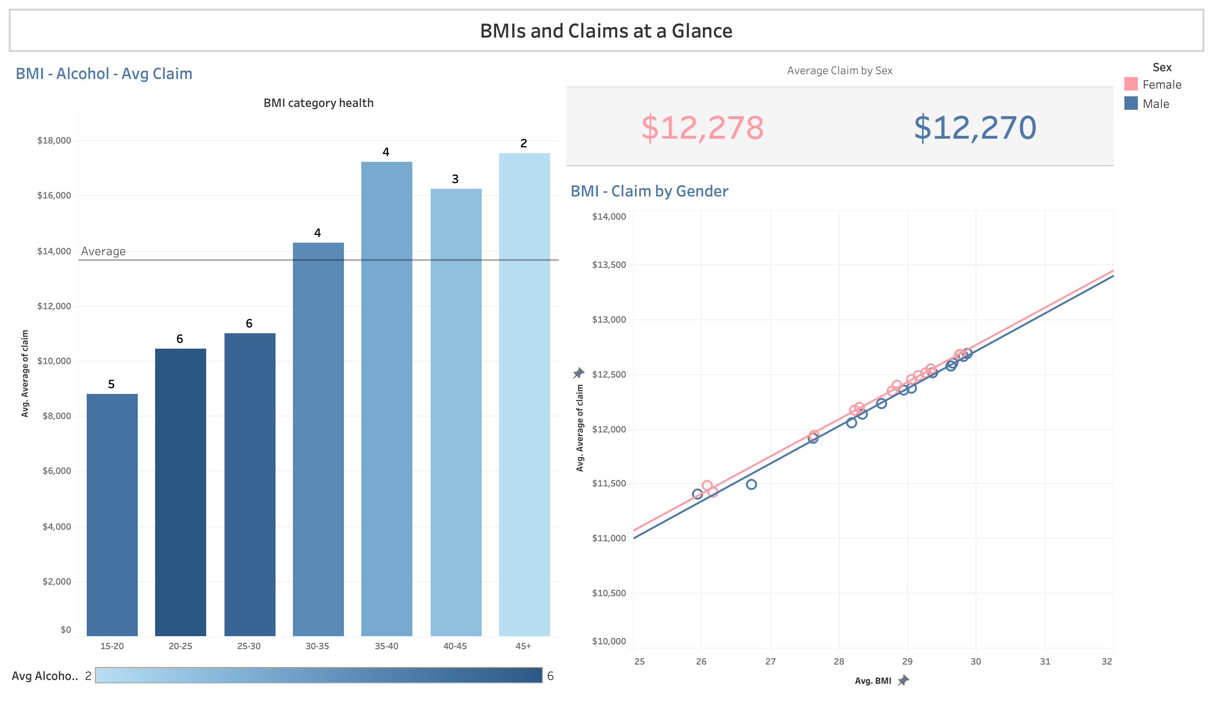

Slide 5
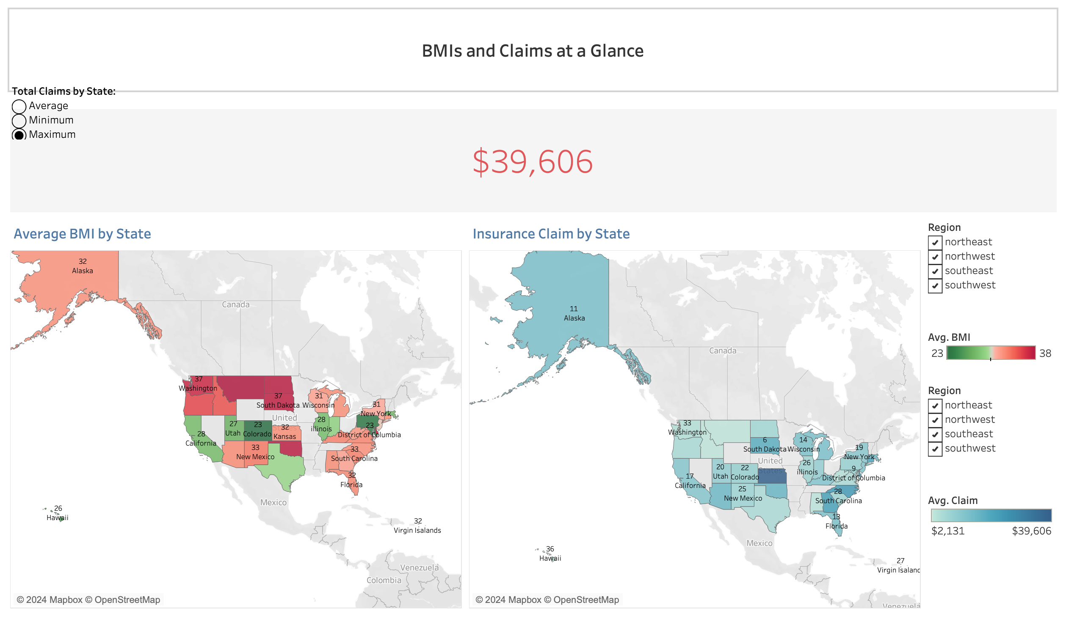

Slide 6
